Slide 1
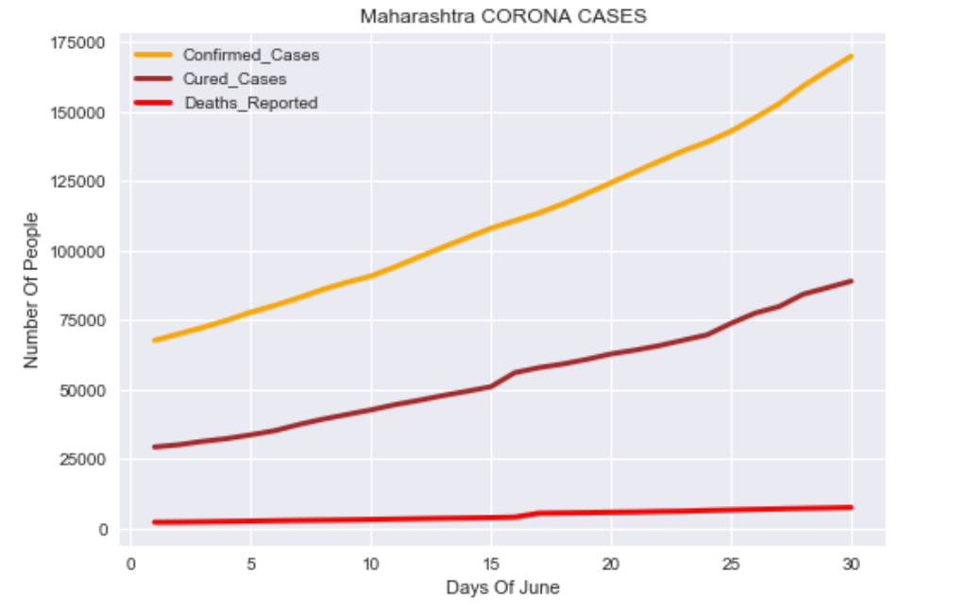
Minor Project Report for State Maharashtra

